Slide 1

Welcome
(E-Commerce website)

Slide 2
Jamali-Collection
(E-Commerce website)

Slide 3
Tech Requirements
Abeda inamdar senior college
Presentation by: Submited to:
Daudibohra mufaddal HOD MA’AM

Slide 4

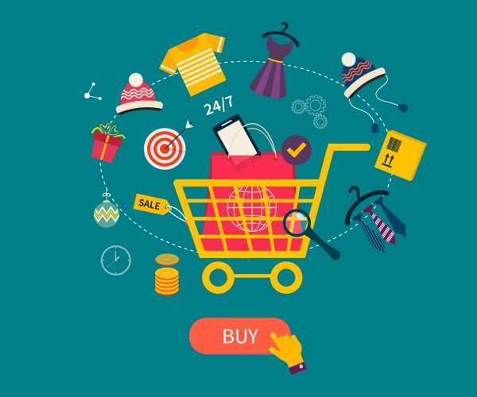
Presentation
Jamali-Collection
Shopping
Website
This Photo by Unknown Author is licensed under CC BY-SA

Slide 5

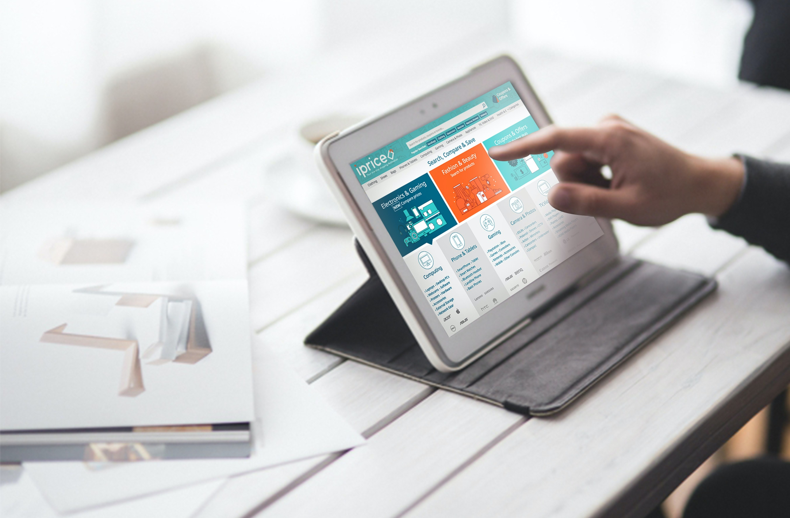
Tech Requirements
In this pandemic online Shopping is very helpful system to buy things at home

Slide 6
Contents-
Introduction
Problem Definition
Scope of the system
Tools and technology
Project description
Conclusion

Slide 7
Introduction
India has often been called a nation of shopkeepers. Presumably there reason for this is that a large number of retail enterprises exist in India.
This project is a web based shopping system for an existing shop. The project objective is to deliver the online shopping application into website platform.
Online shopping is the process whereby consumers directly buy goods or services from a seller in real-time, without an intermediary service, over the Internet. It is a form of electronic commerce. This project is an attempt to provide the advantages of online shopping to customers of a real shop. It helps buying the products in the shop anywhere through internet by using an internet. Thus the customer will get the service of online shopping and home delivery from his favorite shop

Slide 8
Problem definition
The current system for shopping is to visit the shop manually and from the available product choose the item customer want and buying the item by payment of the price of the item .
It is less user-friendly.
User must go to shop and select products.
It is difficult to identify the required product.
Description of the product limited.
It is a time consuming process
Not in reach of distant users.

Slide 9
Scope of the system
This system can be implemented to any shop in the locality or to multinational branded shops having retail outlet chains. The system recommends a facility to accept the orders 24*7 and a home delivery system which can make customers happy.
If shops are providing an online portal where their customers can enjoy easy shopping from anywhere, the shops won’t be losing any more customers to the trending online shops such as flipkart or ebay. Since the application is available in the Smartphone it is easily accessible and always available.

Slide 10


Tools used
Vs Code : its is the text editor of atmost all languages I have use it for html, css, react, javascript
MongoDB: mongo on a cloud I use Atlas that is mongo db part to store data on a cloud

Slide 11
Front end tech
Javascript ( with React Framework)
Html for structuring website
Css to give style in webpage
Material Ui icons to give some icons where it needed

Slide 12
Back end tech
Node.js for server site programming with npm package manager
Expresse.js for routine
Express validator for validation form
Mongodb for storage
Firebase for hosting site on internet

Slide 13
Project description
This Project build in three Module Which are as
Jamali-Collection
Admin
Seller
Customer

Slide 14
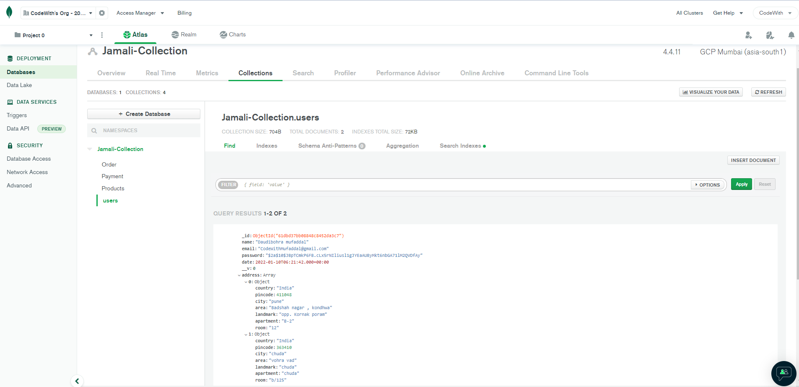
Data base

Slide 15
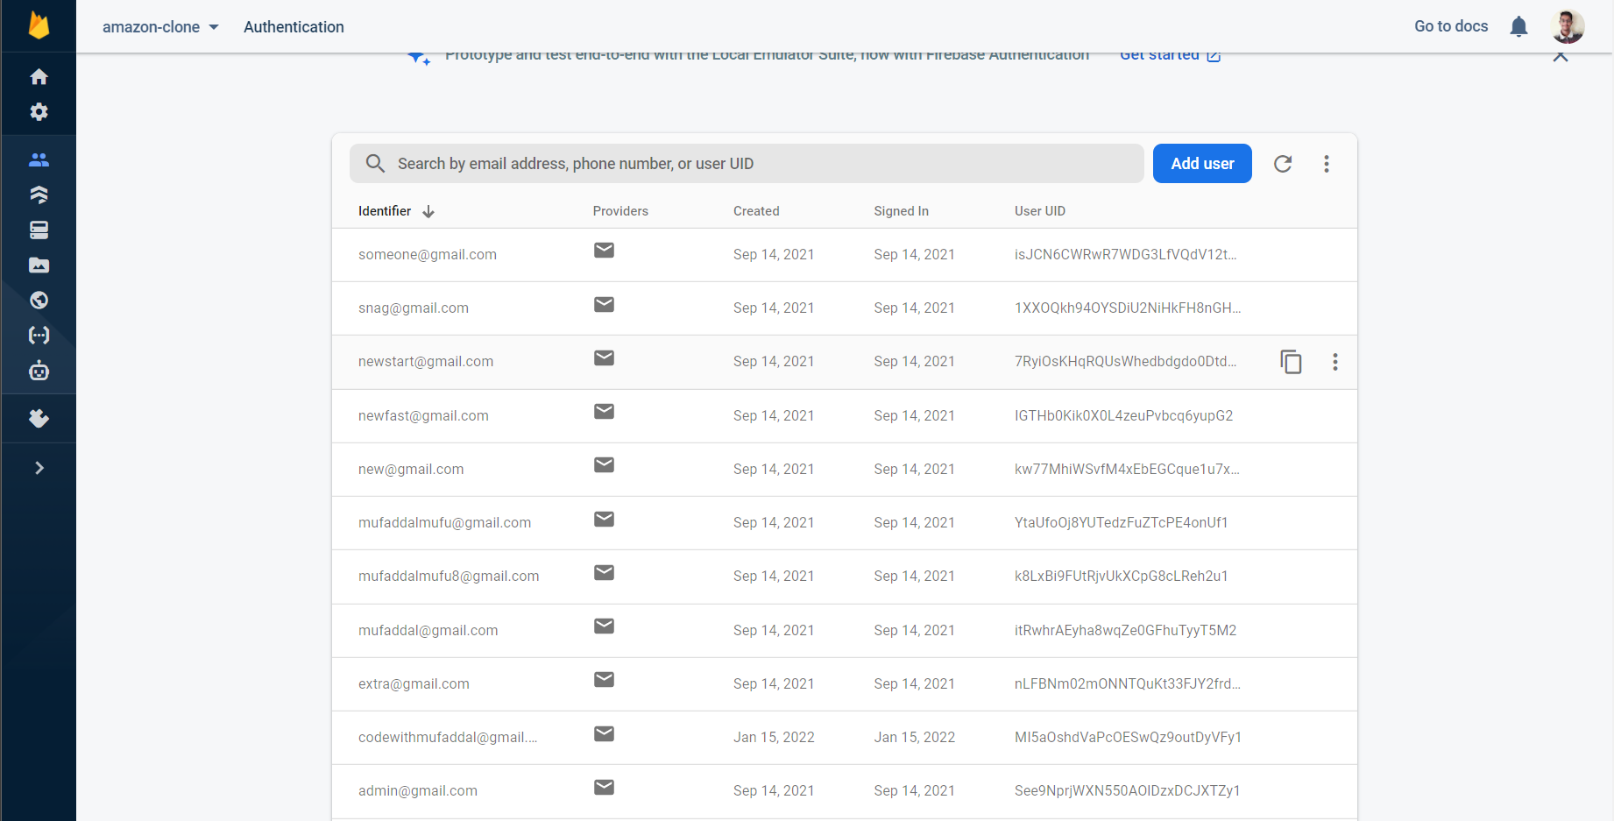
Login details store hear

Slide 16
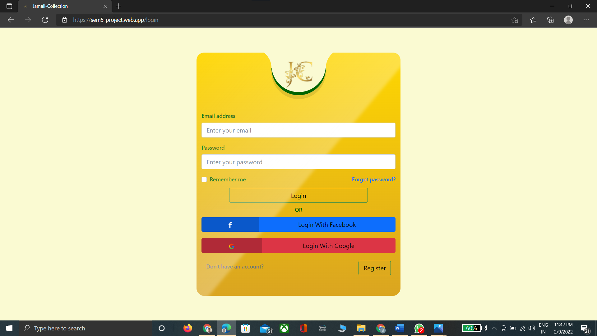
Login page

Slide 17
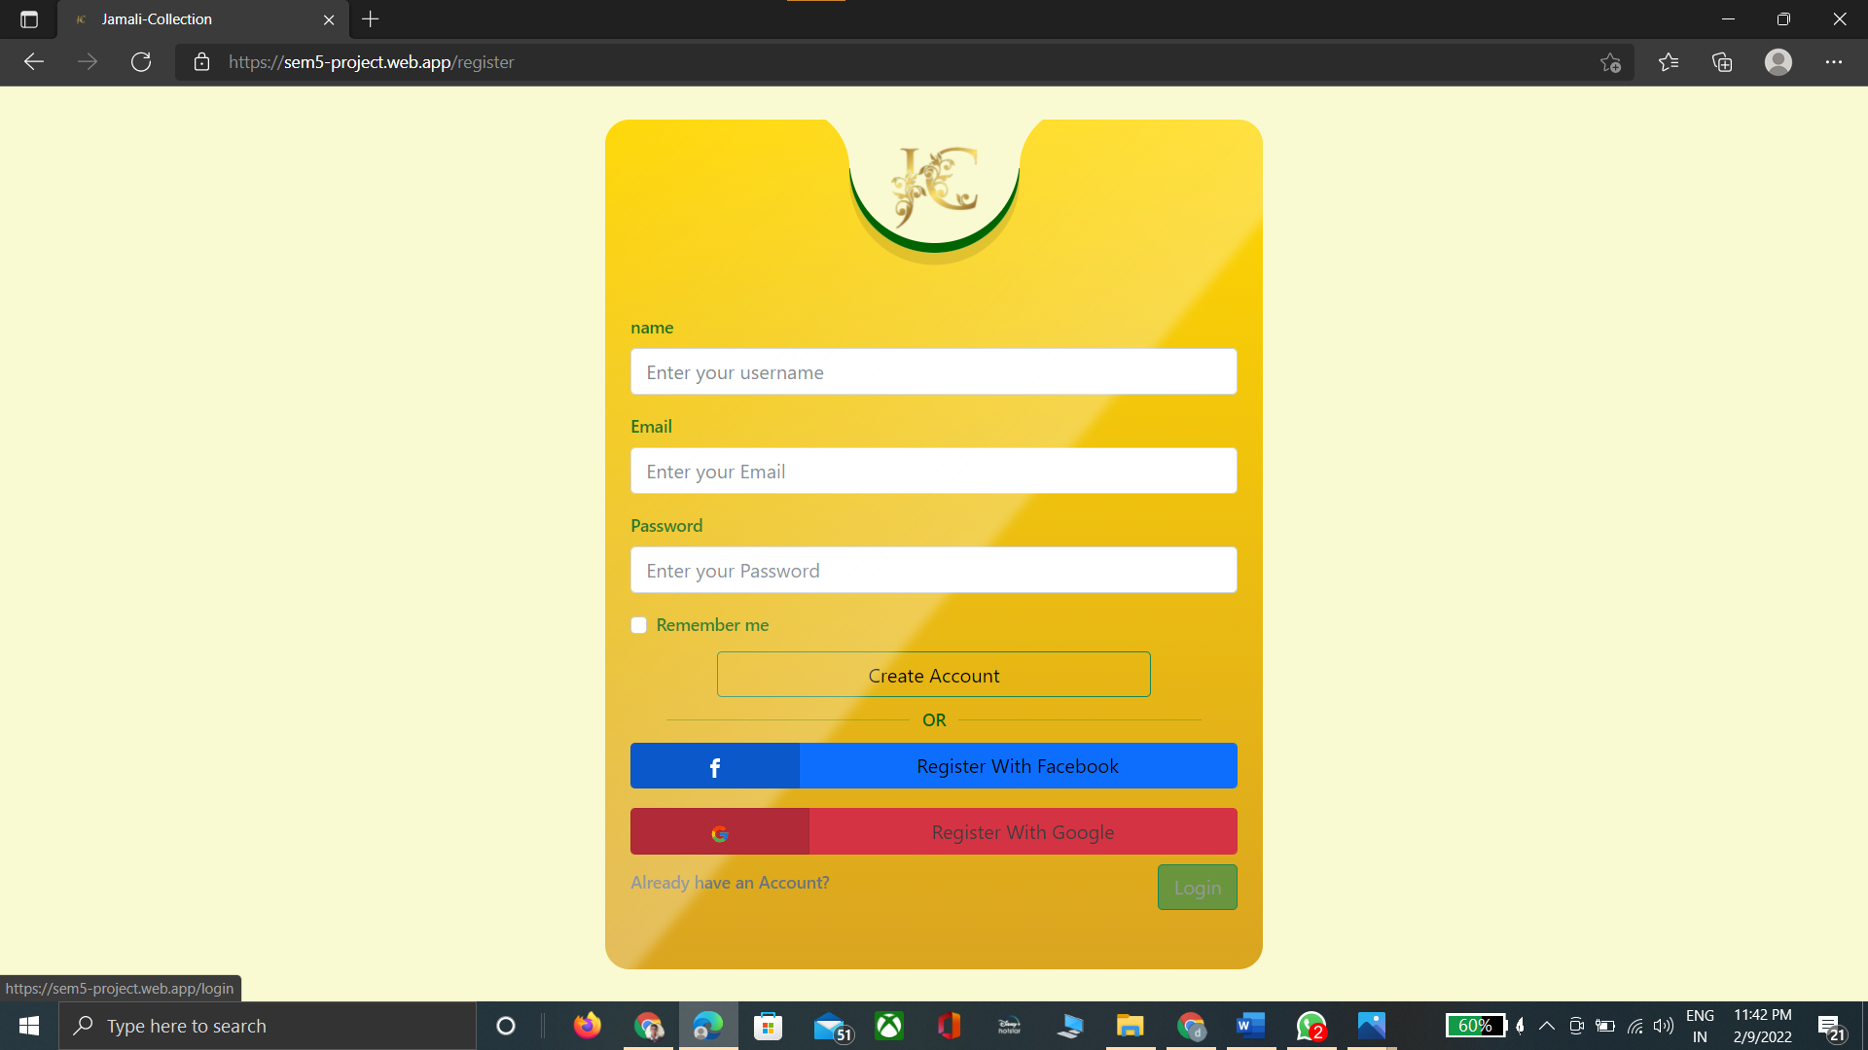
Registration page

Slide 18
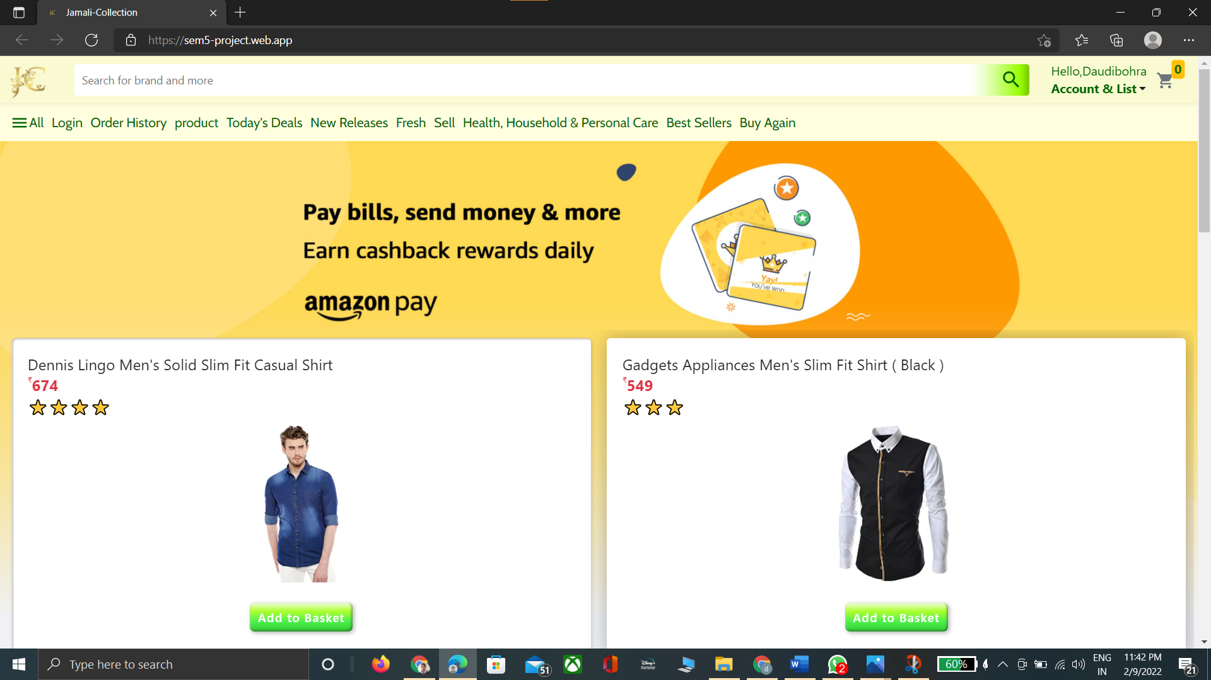

Landing page

Slide 19
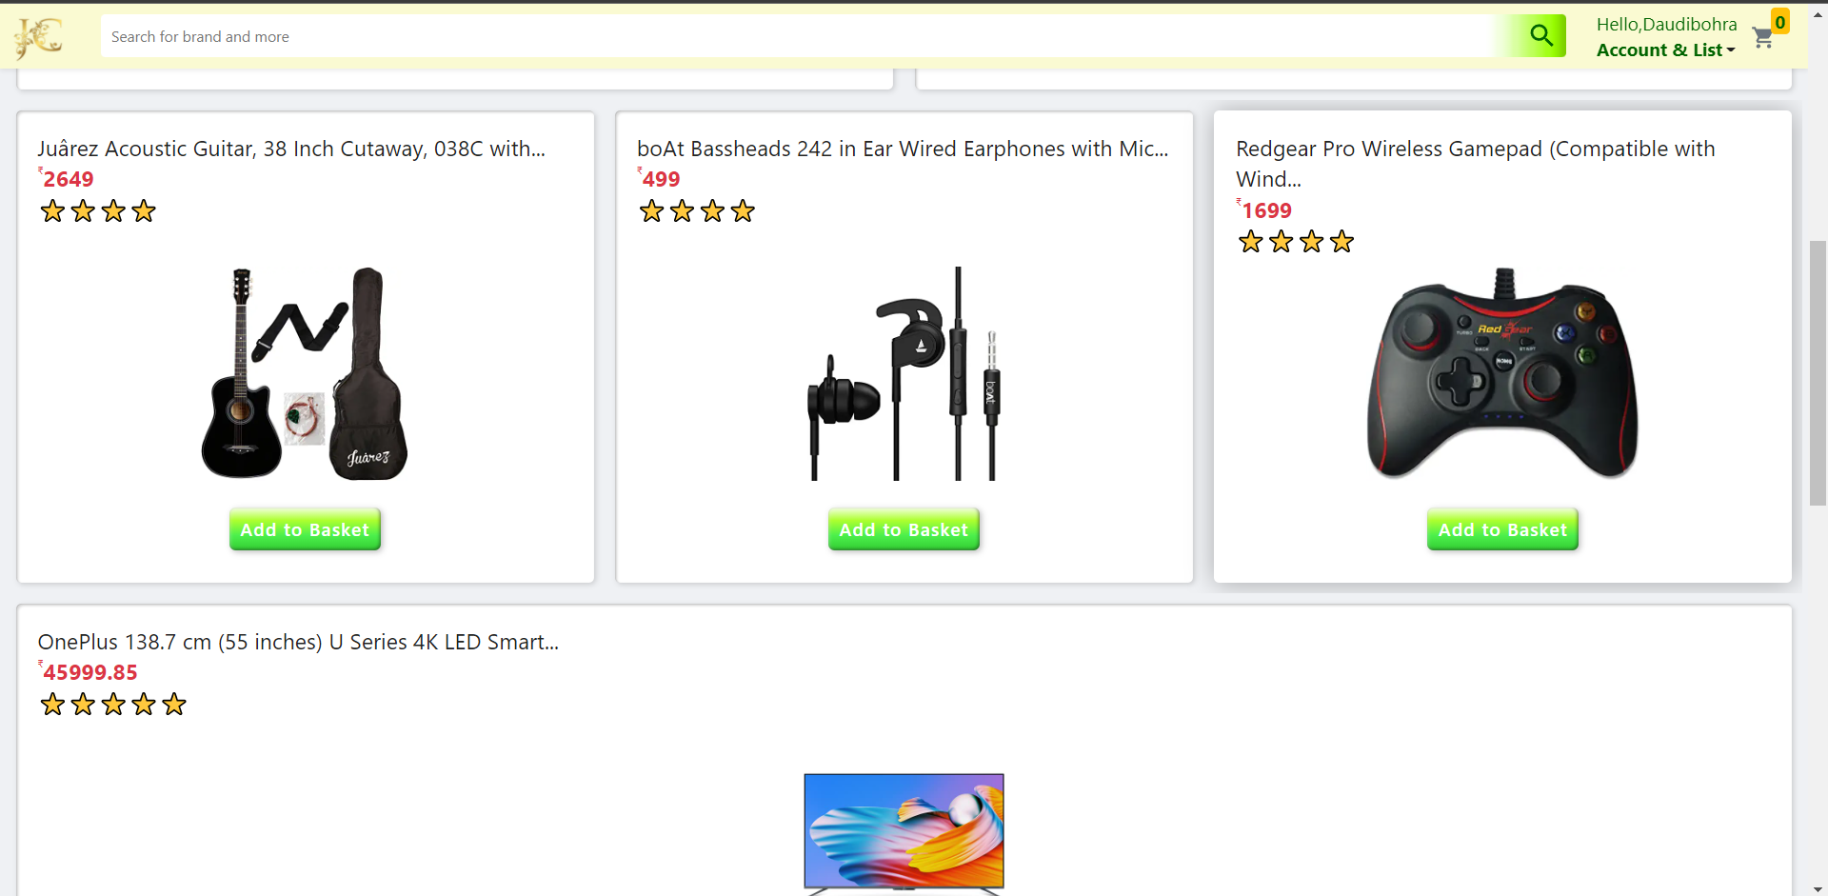
Landing page

Slide 20
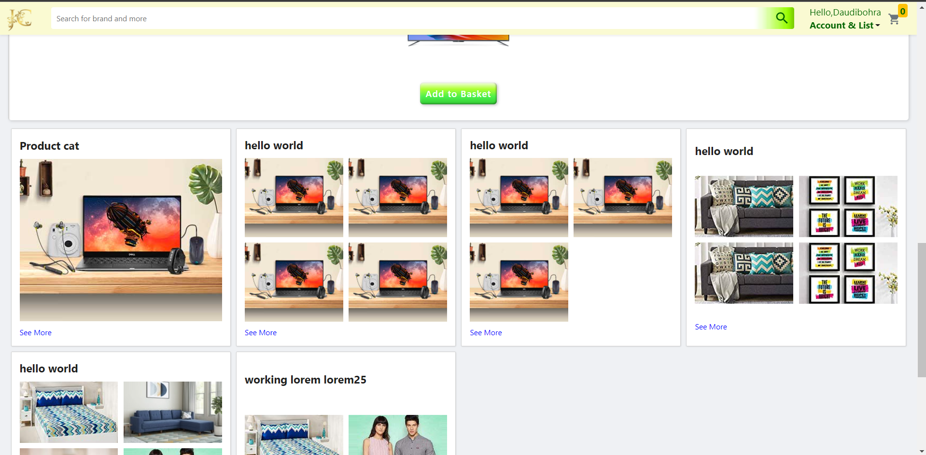
Landing page

Slide 21
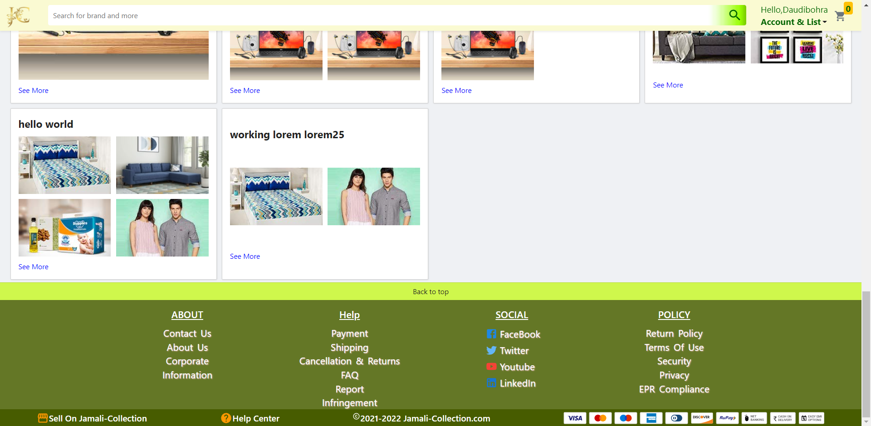
Landing page

Slide 22
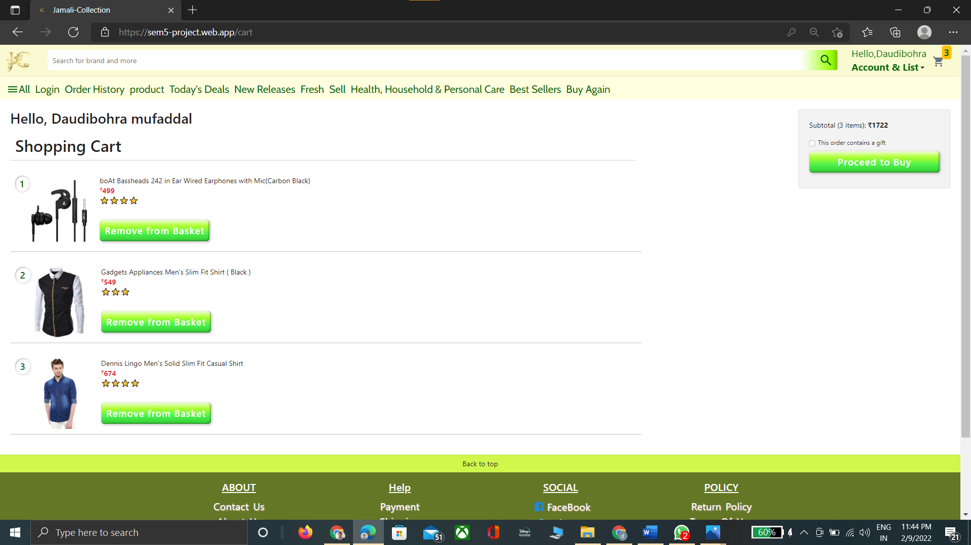


Cart page

Slide 23
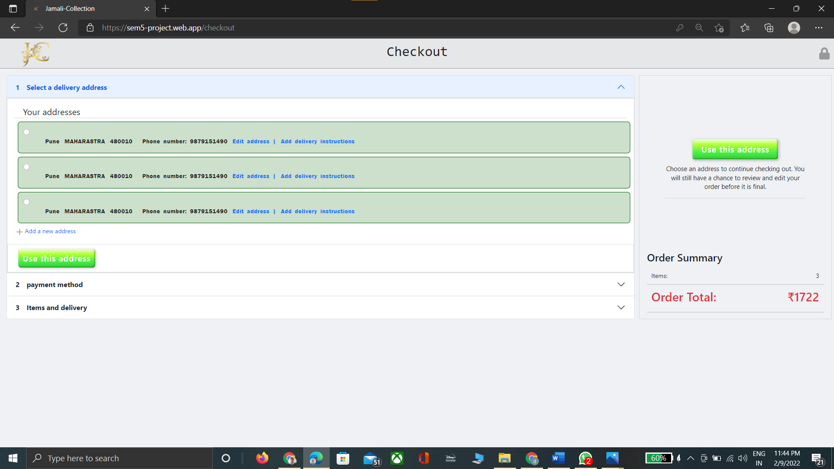
Checkout Page

Slide 24
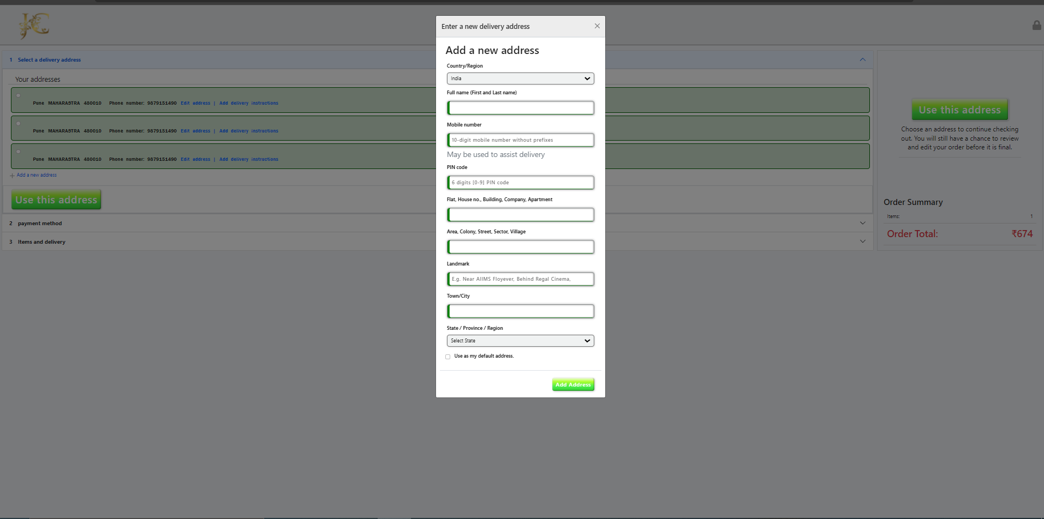
Address modal

Slide 25
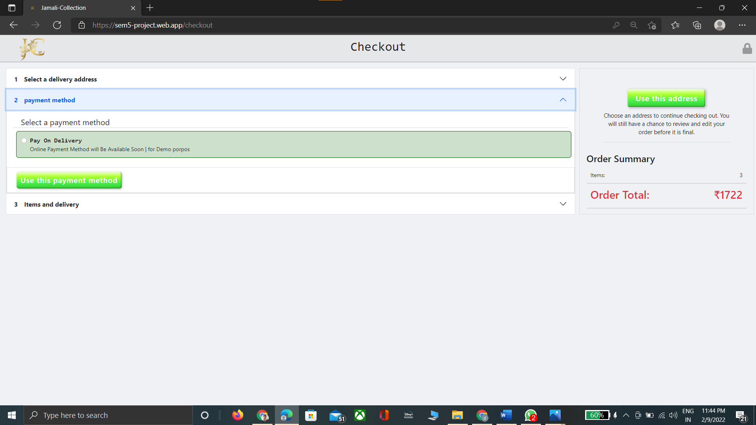
Final Cod

Slide 26
conclusion
The project entitled Jamali - Collection was cmompleted successfully.
The purpose of this project was to develop a web application for purchasing items from a shop.
This project helped us in gaining valuable information and practical knowledge on several topics like designing web pages using html & css, Javascript ,react and management of database using mongodb and server site rendering via node.js , express.js .
Also the project helped us understanding about the development phases of a project and software development life cycle. We learned how to test different features of a project.

Slide 27

Thank You
By
Daudibohra mufaddal

